Slide 1
Company Overview

Slide 2
Groove is poised to be the leading Bahamian personal travel companion, connecting travelers and tourism companies through a new AR-augmented marketplace.

Slide 3
Market Insights
Tourists want to have more intimate and cultural experiences
Small tourism business owners typically do not have the resources or the marketing skills to compete in the tourist market

Slide 4
Tourists
PROBLEM
Demand for unique local curated experiences
Demand for Cultural Immersion
Local Music, Art, History
Limited visibility of merchant ecosystem
Limited entertainment options
Need for safe payment method
Require searchable, multi-modal transportation in real time
Desire to save money
SOLUTION
Next generation Smart Travel Assistant
Groove marketplace
Amazing locally-curated self-guided experiences
Virtual Reality Tours
Wifi and data communication services
Transportation services
Products designed for tourist consumption.

Slide 5
Merchants
PROBLEM
Limited tools for entrepreneurs
High fees for travel platforms
Limited visibility for smaller operators
Limited promotion and bundling
Limited Access to tourist nearby
No solution for reactionary ads
SOLUTION
Digital marketing advertising platforms
Geolocation based recommendation engine
Lower cost for vendors and merchants
In-app push notifications
Bundling opportunities with other merchants
Print advertising
Traditional and Non-traditional advertising opportunities for companies targeting tourists.
Groove Productivity Suite
Booking.•POS•Ticketing•Payment Gateway

Slide 6
Merchants
Tourists
Tourists
Customer Care
Navigation
Advertising and Promotion
Curated tours and Attractions
Booking and ticketing
Immersive AR
Point of Sale and Payment
Data and Communications
Customer Data
Transportation
Notes:
B2B
Customer Care
Advertising and promotion
Booking and ticketing
Point of sale and payment
Customer data (new one added)
B2C
Navigation
Curated tours and Attractions
Immersive AR
Data and Communications
Transportation

Slide 7
Competition
Cruise line and hotel tour desks and concierge services
Traditional print and digital travel platforms
Travel and leisure booking platforms

Slide 8
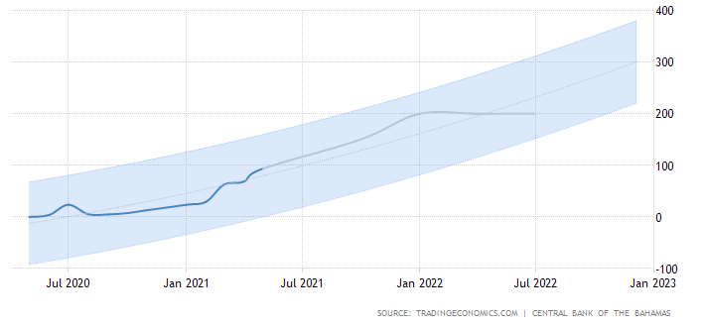
Tourist Arrivals in The Bahamas
ON THE MEND!!!!!!
https://tradingeconomics.com/bahamas/tourist-arrivals

Slide 9
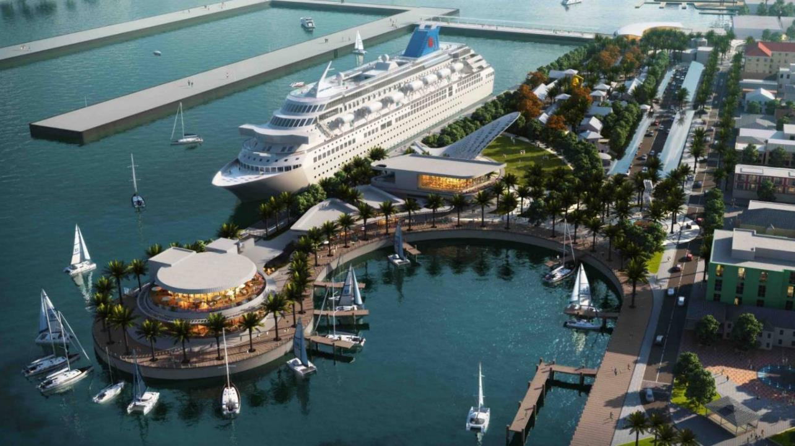
Local Trends
Multi-Billion dollar Port Expansion
Royal Caribbean’s new Home Port
Two New Hotels opened in 2021
High demand for travel post COVID
https://ewnews.com/get-ready-to-invest-nassau-cruise-port-initial-public-offering-for-bahamians-expected-in-october-says-mike-maura-ceo

Slide 10
1st Mover Advantage
Currently no tour company in the region offers self-guided tours (only group bus tours)
The Groove app enables personalized and customized tour experiences across wide geographic areas and markets
Groove provides a no wait, walk-up service or can be ordered anywhere
Groove integrations with network of taxis, ferries and jitneys make transportation more accessible and affordable for tourists
Convenient cashless transactions enabled and managed by the app
Geo-based and real-time reactionary advertising for merchants and tourist companies maximize revenue and utilize unused service capacity

Slide 11
Traction
$270,000
2020 pre-Covid ad sales
Technology
Significant investments made
Relationships
Direct relationships with merchants and operators

Slide 12
Vision
Bahamas
Caribbean
Worldwide

Slide 13
Reasons to Invest
Technology-driven, user experience focused
Demand for high-quality tourist attractions
First mover advantage
Significant advertising, tour and commission revenue
This will be the leading tourism marketplace in the Bahamas

Slide 14
Roadmap
2021-22
Q4 2021
Hire Staff
Purchase Assets
Continue Development Phase I
Launch Phase I – Tours/Wifi/Ads/Saas
Q1 2022
Launch Phase II – Transportation Module
Production Studio
Digital Asset Expansion
Q2 2022
Launch Phase III – Gamification/ Interior Mapping
Expand to Family Islands
Q3 2022
Test Phase IV – Franchise Model
Hire Marketing/Legal For International Launch
Q4 2022
Complete Intellectual Property Acquisition

Slide 15
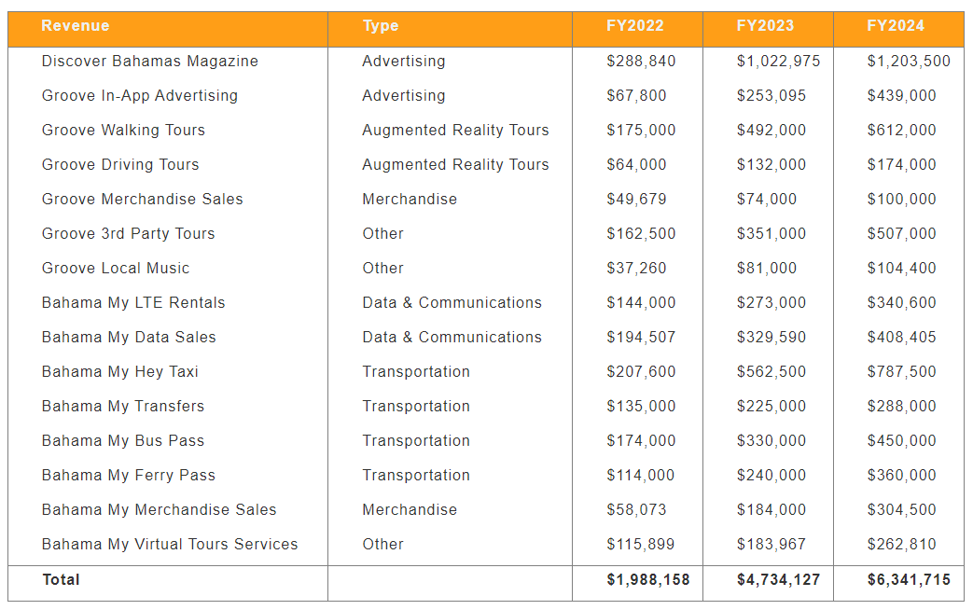
Revenue

Slide 16
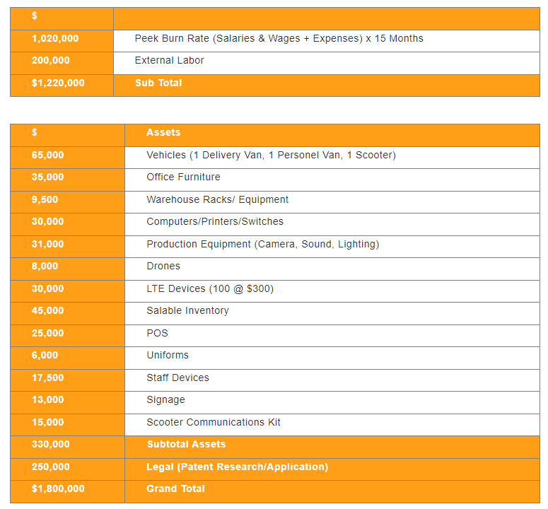
Use of Funds

Slide 17
Company Valuation
Harvard Business Review Valuation | $15,840,000
Equity Offered | 20%
Investment Sought | $1,800,000
Total Shares Outstanding | 1,000,000
Price Per Share | $15.84

Slide 18
Our Team

